Slide 1
Trajectory Planning
Lee Yongseok, Jung Hyunseo
dldydtjr2000@postech.ac.kr

Slide 2
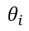
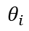
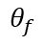
1. Trajectory planning
Trajectory
For robot motion, pose of the robot should be specified as a function of time and it is called the trajectory of the robot.
Trajectory should be a sufficiently smooth function of time, and should respect any given limits on joint velocities, accelerations, or torques.
There are some cases where we have freedom to design the trajectory. For example, when we want a point-to-point motion, it is our choice on how to move the robot from starting point to end point.
$$θ_{f}$$
$$θ_{f}$$
$$θ_{i}$$
$$θ_{i}$$

Slide 3
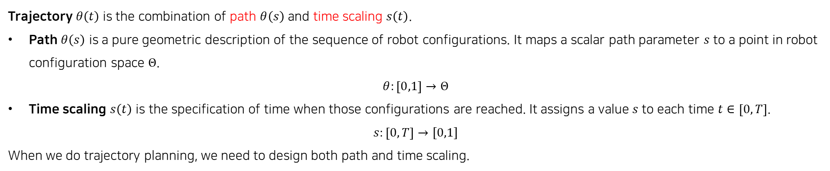
1. Trajectory planning
Path and time scaling
Trajectory $θ\left(t\right)$ is the combination of path $θ\left(s\right)$ and time scaling $s\left(t\right)$.
Path $θ\left(s\right)$ is a pure geometric description of the sequence of robot configurations. It maps a scalar path parameter $s$ to a point in robot configuration space $Θ$.
$$θ:\left[0,1\right]→Θ$$
Time scaling $s\left(t\right)$ is the specification of time when those configurations are reached. It assigns a value $s$ to each time $t∈\left[0,T\right]$.
$$s:\left[0,T\right]→[0,1]$$
When we do trajectory planning, we need to design both path and time scaling.
For path planning:
Point-to-Point
Straight line in joint space
Straight line in task space (coupled/decoupled)
Via-point
Polynomial interpolation (when we use via points)
Spline curve (when we use via points)
For time scaling:
Polynomial time scaling
Limit based time scaling
Trapezoidal time scaling
S-curve time scaling
Time-optimal time scaling

Slide 4
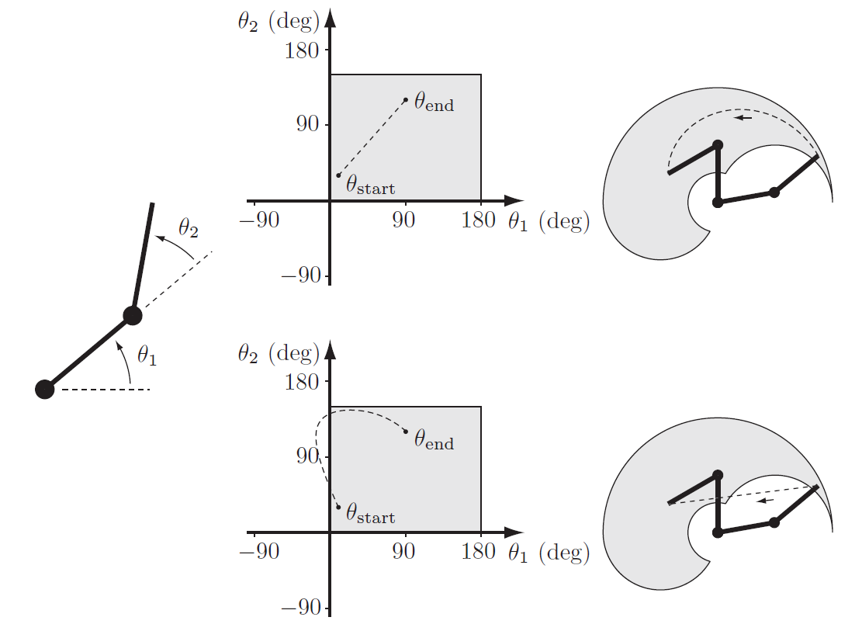
2. Path design
Straight-Line Paths
2R manipulator example
Straight-line in joint space
Straight-line in task space

Slide 5
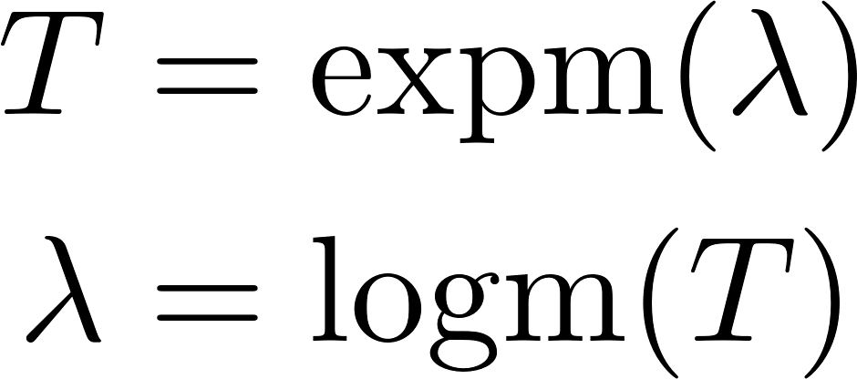
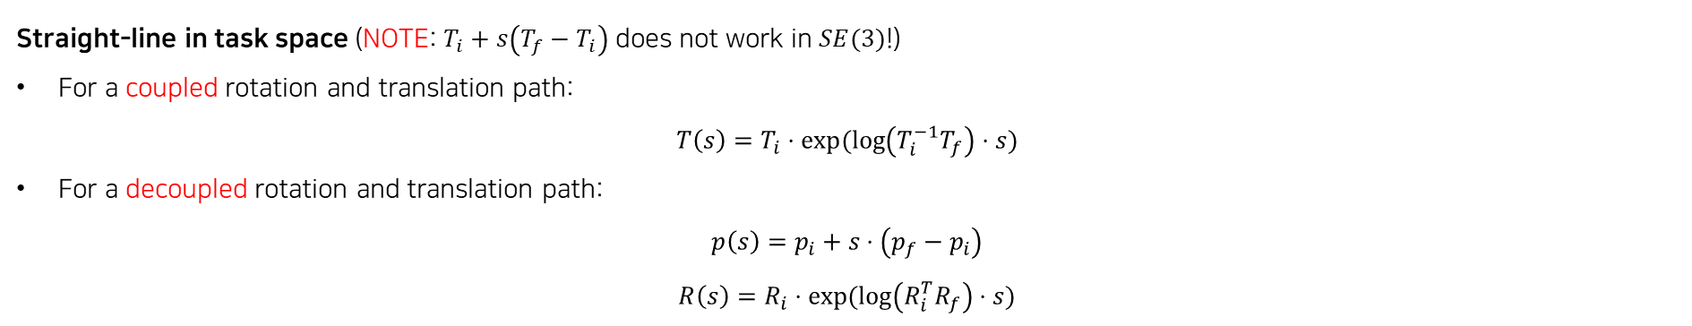
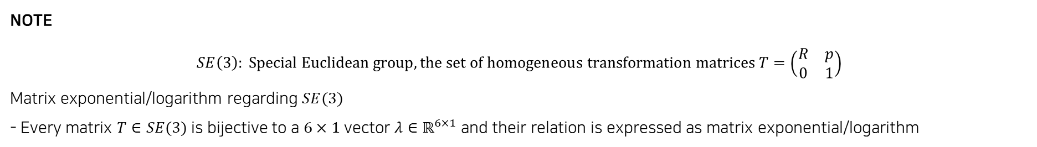
2. Path design
Straight-Line Paths
Straight-line in joint space
$$θ\left(s\right)=θ_{i}+s⋅(θ_{f}−θ_{i})$$
Straight-line in task space (NOTE: $T_{i}+s\left(T_{f}−T_{i}\right)$ does not work in $SE(3)$!)
For a coupled rotation and translation path:
$$T\left(s\right)=T_{i}⋅exp⁡(\log\left(T_{i}^{−1}T_{f}\right)⋅s)$$
For a decoupled rotation and translation path:
$$p\left(s\right)=p_{i}+s⋅\left(p_{f}−p_{i}\right)$$
$$R\left(s\right)=R_{i}⋅\exp{(\log\left(R_{i}^{T}R_{f}\right)⋅s)}$$
NOTE
$SE\left(3\right)$: Special Euclidean group, the set of homogeneous transformation matrices $T=\left(\begin{matrix}R & p \\ 0 & 1\end{matrix}\right)$
Matrix exponential/logarithm regarding $SE(3)$
- Every matrix $T∈SE(3)$ is bijective to a $6×1$vector $λ∈ℝ^{6×1}$ and their relation is expressed as matrix exponential/logarithm

Slide 6
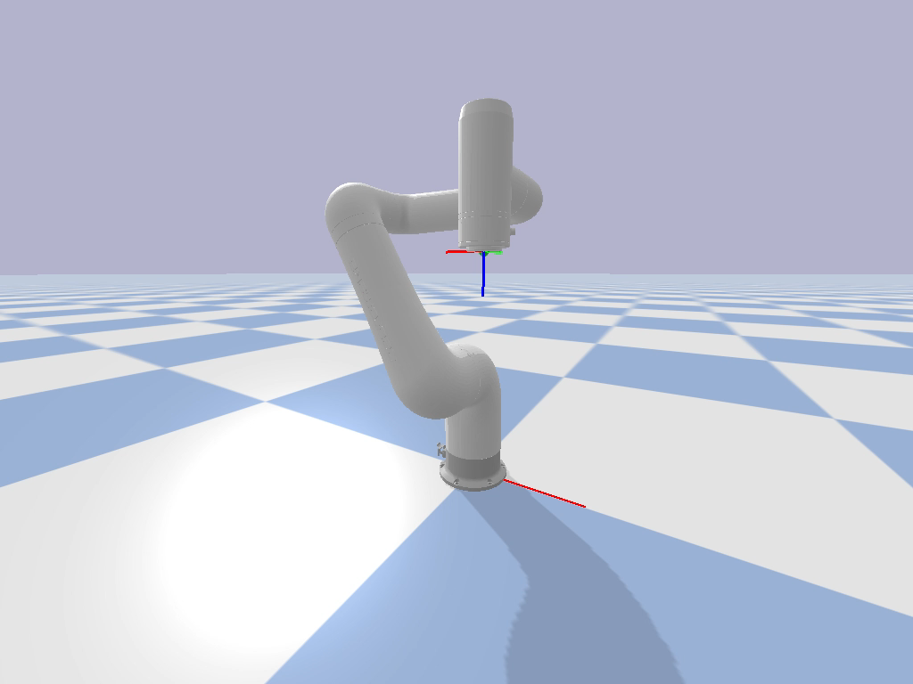

2. Path design
Straight-Line in Task Space – coupled vs decoupled
Coupled rotation and translation – we can observe straight screw motion
Decoupled rotation and translation – we can observe straight translation

Slide 7
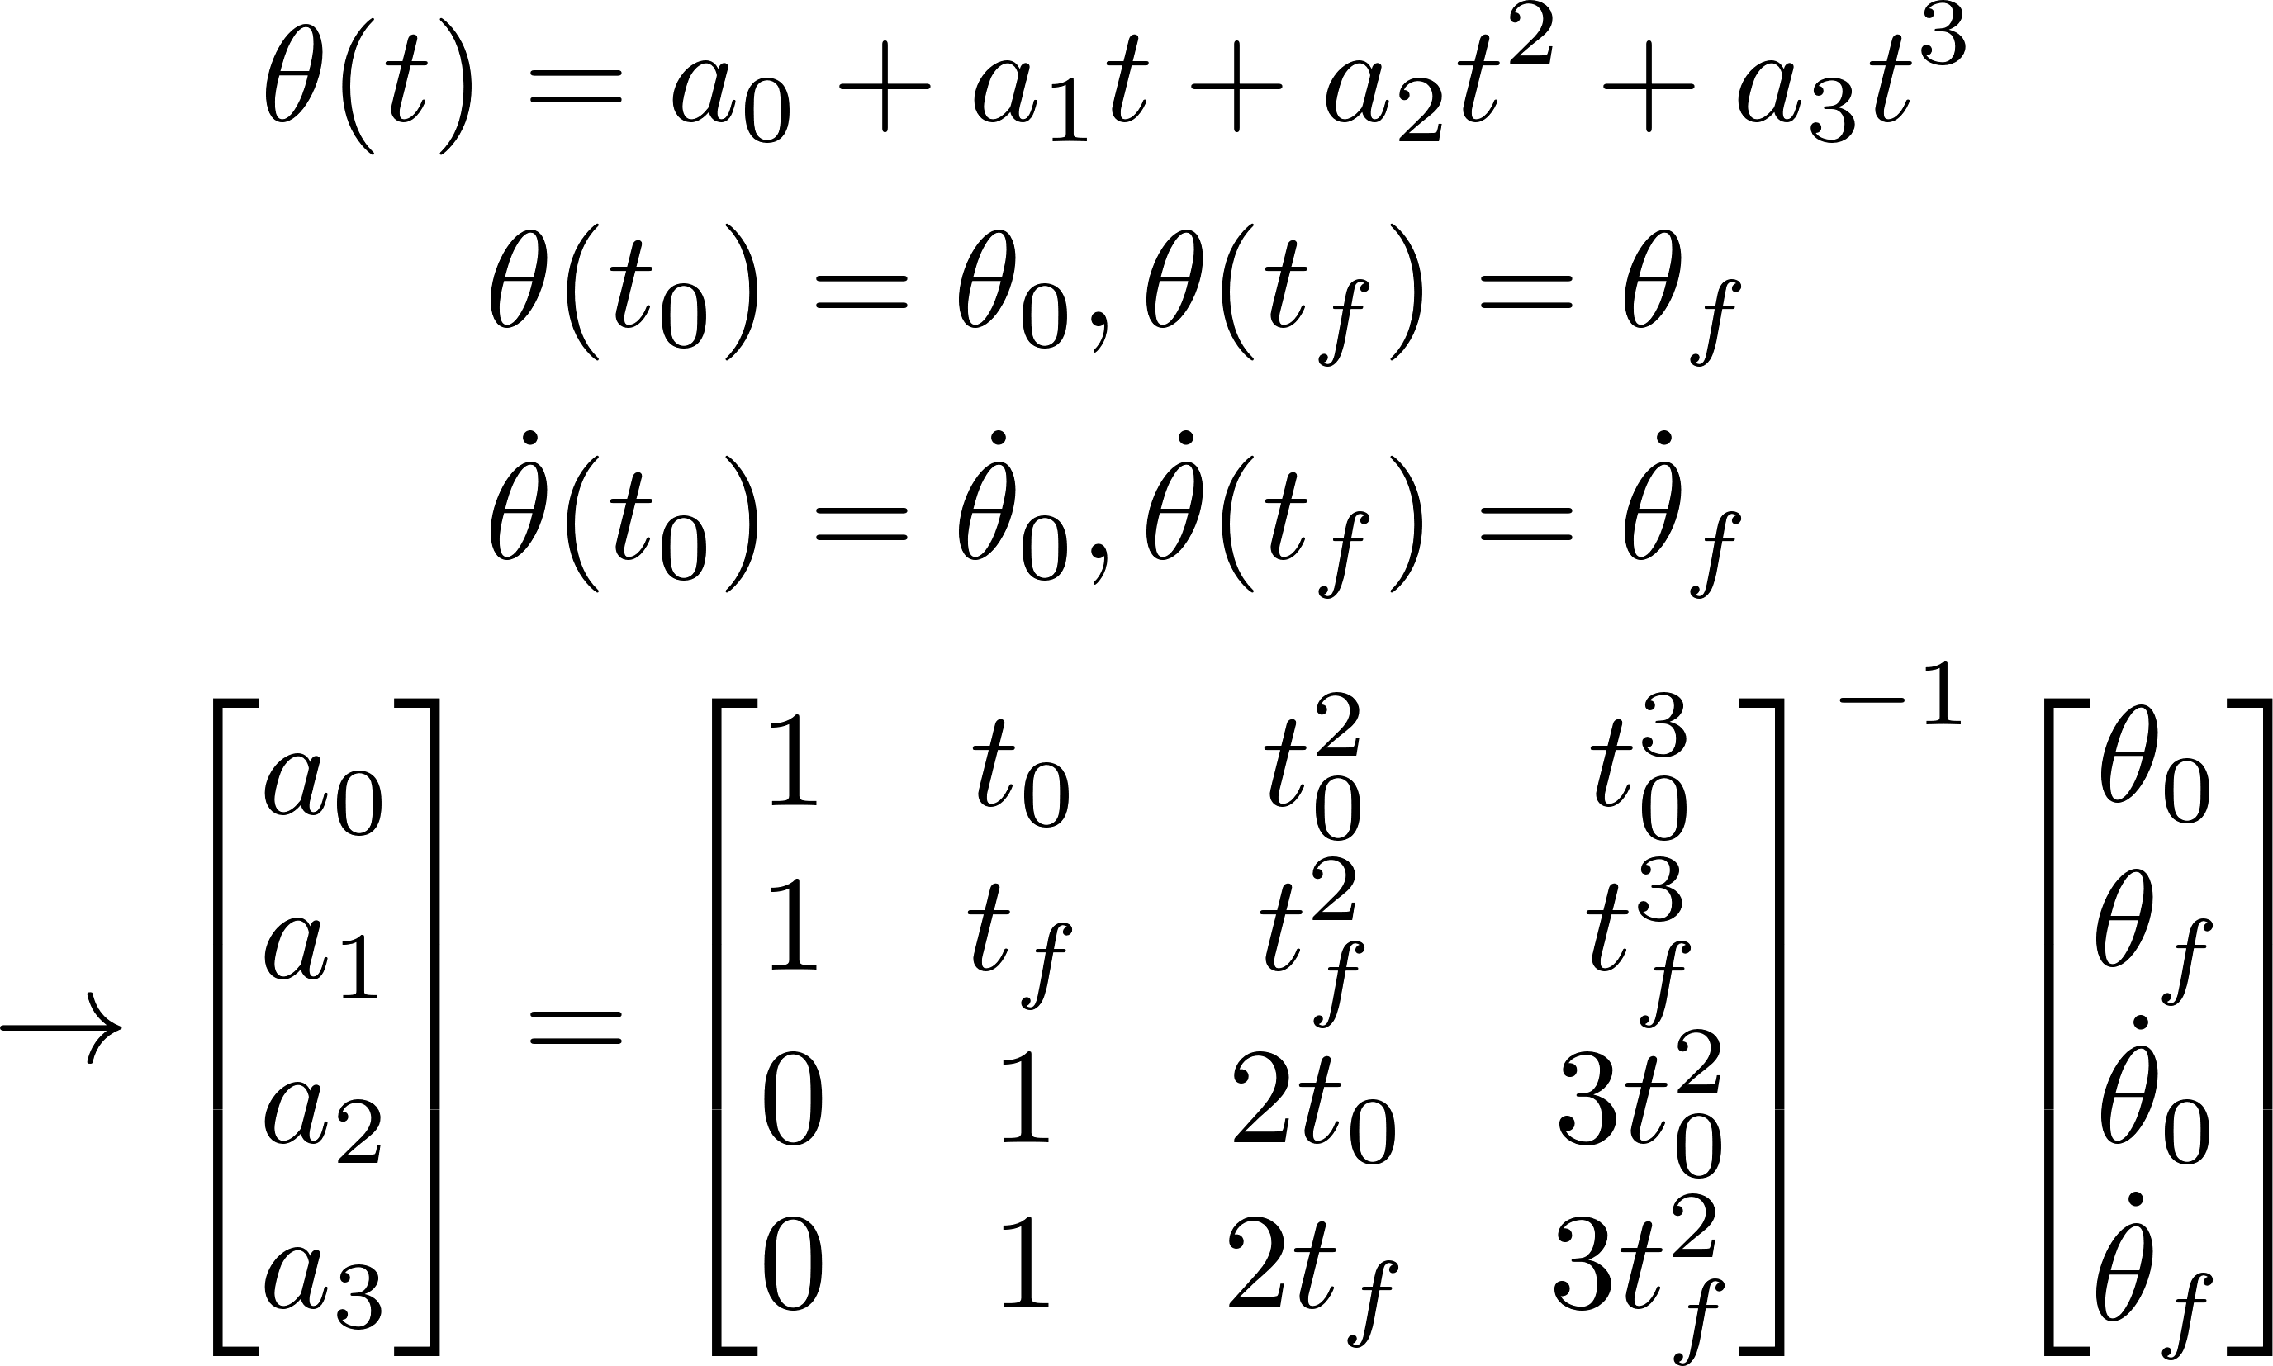
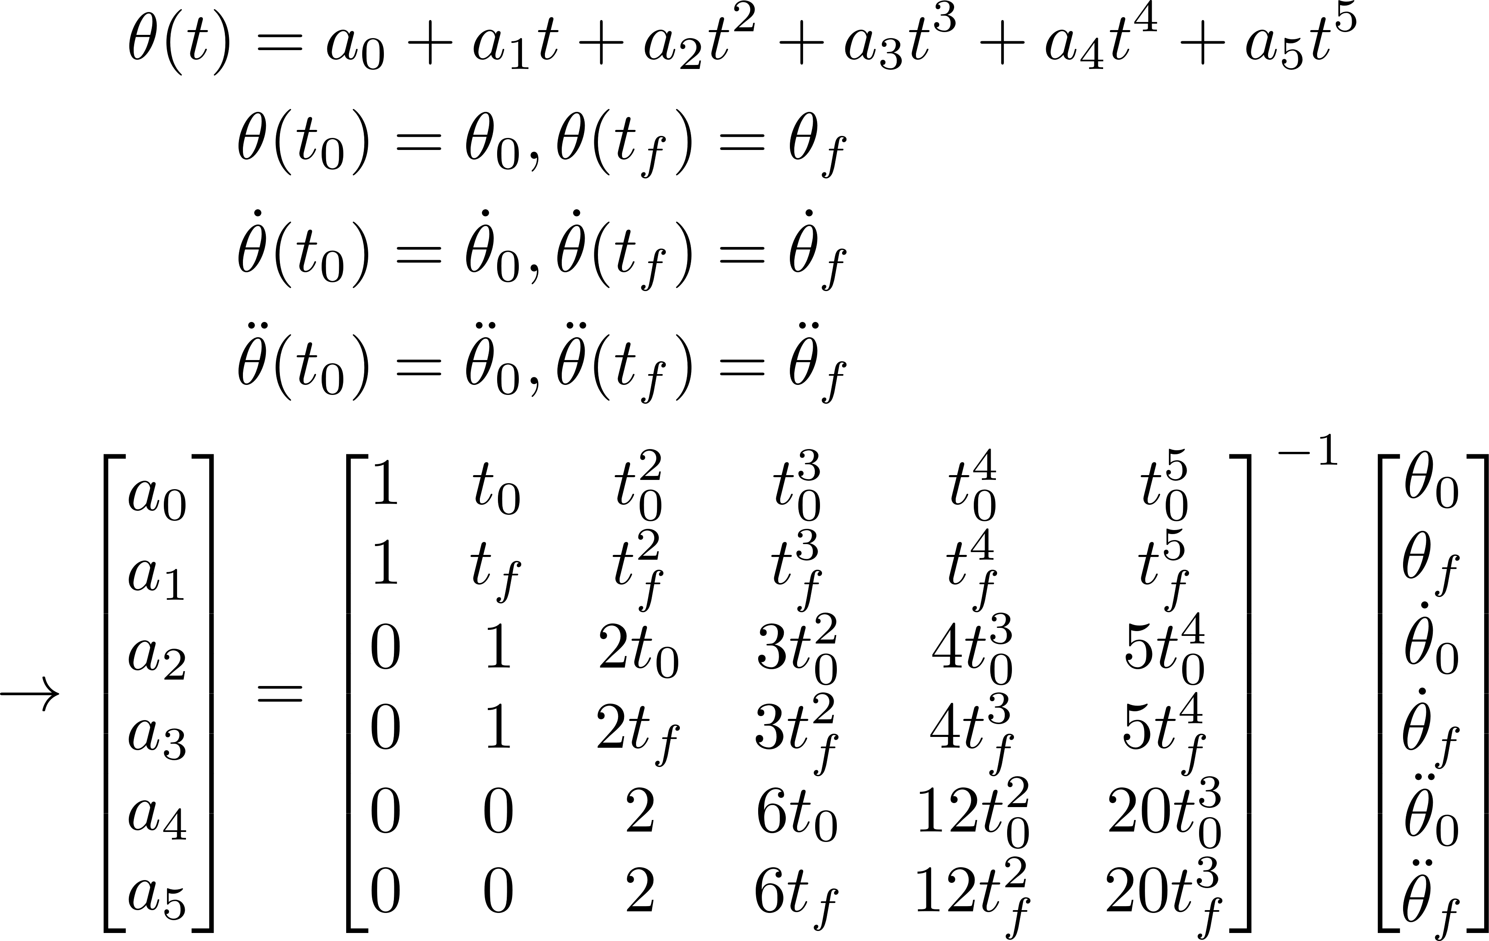
3. Time scaling
Polynomial interpolation
3rd order polynomial interpolation
In the case initial/final position conditions and velocity conditions are specified.
5th order polynomial interpolation
In the case initial/final position conditions, velocity conditions, and acceleration conditions are specified.

Slide 8
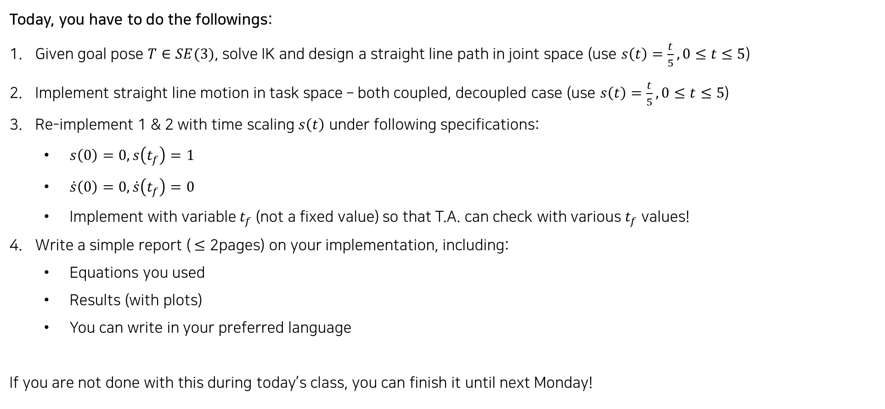
4. Practice
Today, you have to do the followings:
Given goal pose $T∈SE(3)$, solve IK and design a straight line path in joint space (use $s\left(t\right)=\frac{t}{5}, 0≤t≤5$)
Implement straight line motion in task space – both coupled, decoupled case (use $s\left(t\right)=\frac{t}{5}, 0≤t≤5$)
Re-implement 1 & 2 with time scaling $s\left(t\right)$ under following specifications:
$s\left(0\right)=0, s\left(t_{f}\right)=1$
$\dot{s}\left(0\right)=0, \dot{s}\left(t_{f}\right)=0$
Implement with variable $t_{f}$ (not a fixed value) so that T.A. can check with various $t_{f}$ values!
Write a simple report ($≤$ 2pages) on your implementation, including:
Equations you used
Results (with plots)
You can write in your preferred language
If you are not done with this during today’s class, you can finish it until next Monday!

